Slide 1
Early Detection of DDoS Attacks against SDN Controllers
Author: Seyed Mohammad Mousavi, Marc St-Hilaire
Conference: 2015 International Conference on Computing, Networking and Communications (ICNC)
Presenter: Chih-Hsun Wang
Date: 2015/08/05
Department of Computer Science and Information Engineering
National Cheng Kung University, Taiwan R.O.C.
Notes:
1

Slide 2
Introduction
A Software Defined Network (SDN) is a new network architecture that provides central control over the network.
The main goal of this paper is to detect a DDoS attack in its early stages.
This paper provides a solution to detect DDoS attacks based on the entropy variation of the destination IP address.
This method is able to detect DDoS within the first five hundred packets of the attack traffic.

Slide 3
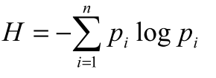
DDoS Detection Using Entropy
The main reason entropy is used for DDoS detection is its ability to measure randomness in the packets that are coming to a network.
The higher the randomness the higher is the entropy.
There are two essential components to DDoS detection using entropy:
i) window size
ii) threshold
Notes:
Window size is either based on a time period or a number of packets.
Entropy is calculated within this window to measure uncertainty in the coming packets.
To detect an attack, a threshold is needed.
If the calculated entropy passes a threshold or is below it, depending on the scheme, an attack is detected.

Slide 4
Proposed Method
Utilizing SDN Capabilities
Knowing that the packet is new and that the destination is in the network, the level of randomness can be quantified by calculating the entropy based on a window size.
Using entropy, it is possible to see its value drop when a large number of packets are attacking one host or a subnet of hosts.

Slide 5
Proposed Method
Statistics Collection for Entropy
One of the functions of the controller is collecting statistics from the switch tables.
The entropy of each window is calculated and compared to an experimental threshold. If the entropy is lower than the threshold, an attack is detected.

Slide 6
Proposed Method
Window Size
The window size should be set to be smaller or equal to the number of hosts.
The main reason for choosing 50 is the limited number of incoming new connection to each host in the network.
Considering the limited resources of the controller, this window size is ideal for networks with one controller and few hundred hosts.
Notes:
Here, window size = 50

Slide 7
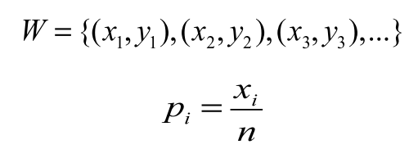
Proposed Method
Attack detection
To detect an attack in the controller, we monitor the destination IP address of the incoming packets.
A function was added to the controller to create a hash table of the incoming packets.
Notes:
W is hash table, Xi is des ip, Yi is 出現次數
Pi is the probability of each IP address.
If an IP address is new in the table, it will be added with count one.
After 50 packets, the entropy of the window will be calculated.

Slide 8
Proposed Method
Attack detection
If an attack is directed towards a host, a large number of packets will be directed to it. These packets will fill most of the window and reduce the number of unique IPs in the windo, which in turn, reduces entropy.
We made use of this fact and set an experimental threshold. If the entropy drops below this threshold and that five consecutive windows have lower than threshold entropy, then an attack is in progress.

Slide 9
Simulation Results
Experiment Environment
Controller | POX
Language | Python
Network Emulator | Mininet
Traffic Generation | Scapy

Slide 10
Simulation Results
Choosing a Threshold
To find the range for an optimal threshold, we ran a series of experiments to see the effect of an attack on the entropy.
We ran a 25% rate attack on one host for 25 times to find a suitable threshold.
This threshold is the highest entropy of all cases so it will enable the controller to detect any attack with packets occupying 25% of the incoming traffic or more.

Slide 11
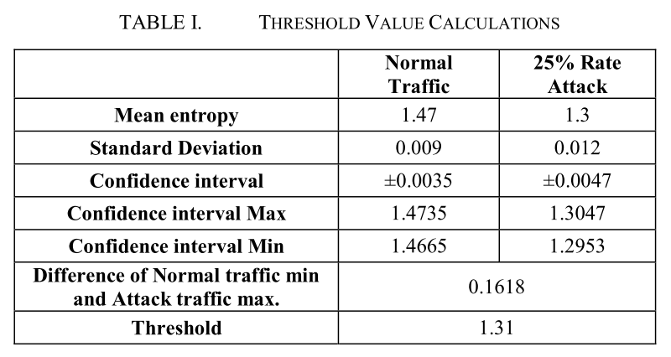
Simulation Results

Slide 12
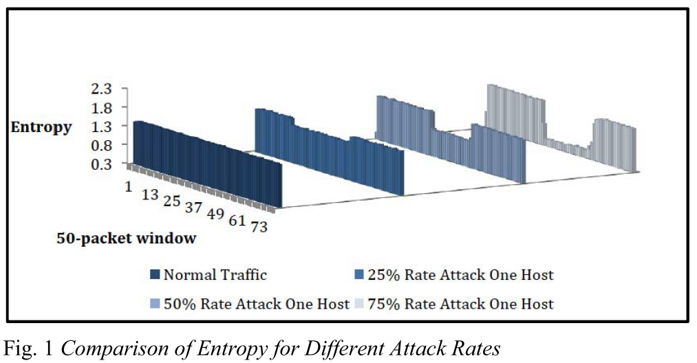
Simulation Results

